Slide 1

Tipos de datos

Slide 2
Vectors
a <- c(1,2,5.3,6,-2,4) # numeric vector b <- c("one","two","three") # character vector c <- c(TRUE,TRUE,TRUE,FALSE,TRUE,FALSE) #logical vector
Refer to elements of a vector using subscripts.
a[c(2,4)] # 2nd and 4th elements of vector

Slide 3
Data Frames
A data frame is more general than a matrix, in that different columns can have different modes (numeric, character, factor, etc.).
d <- c(1,2,3,4) e <- c("red", "white", "red", NA) f <- c(TRUE,TRUE,TRUE,FALSE) mydata <- data.frame(d,e,f) names(mydata) <- c("ID","Color","Passed") # variable names

Slide 4
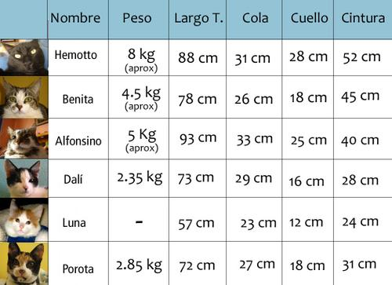
Ejercicio
Capturar tabla y crear data frame llamado “Tabla1”
Paso 1 capturar cada columna como vector
Paso 2 crear tabla uniendo los vectores creados
Paso 3 asignar nombre a cada columna

Slide 5
Datos incluidos en R
Data()
Descripción de datos:
str (Nombre de datos)

Slide 6
Factors
Tell R that a variable is nominal by making it a factor. The factor stores the nominal values as a vector of integers in the range
[ 1... k ] (where k is the number of unique values in the nominal variable), and an internal vector of character strings (the original values) mapped to these integers.
# variable gender with 20 "male" entries and # 30 "female" entries
gender <- c(rep("male",20), rep("female", 30)) gender <- factor(gender)
# stores gender as 20 1s and 30 2s and associates # 1=female, 2=male internally (alphabetically) # R now treats gender as a nominal variable
summary(gender)
An ordered factor is used to represent an ordinal variable.

Slide 7
Missing Data
In R, missing values are represented by the symbol NA (not available)
Testing for Missing Values
is.na(x) # returns TRUE of x is missing y <- c(1,2,3,NA) is.na(y) # returns a vector (F F F T)

Slide 8
Excluding Missing Values from Analyses
Arithmetic functions on missing values yield missing values.
x <- c(1,2,NA,3) mean(x) # returns NA mean(x, na.rm=TRUE) # returns 2
The function na.omit() returns the object with listwise deletion of missing values.
# create new dataset without missing data newdata <- na.omit(x)

Slide 9
Recoding Values to Missing
# recode 99 to missing for variable v1 # select rows where v1 is 99 and recode column v1 mydata$v1[mydata$v1==99] <- NA

Slide 10
Manejo de datos

Slide 11
Sorting Data
To sort a data frame in R, use the order( ) function. By default, sorting is ASCENDING.
Prepend the sorting variable by a minus sign to indicate DESCENDING order. Here are some examples.
# sorting examples using the mtcars dataset attach(mtcars) # sort by mpg newdata <- mtcars[order(mpg),] # sort by mpg and cyl newdata <- mtcars[order(mpg, cyl),] #sort by mpg (ascending) and cyl (descending) newdata <- mtcars[order(mpg, -cyl),] detach(mtcars)

Slide 12
Merging data
Adding Columns
To merge two data frames (datasets) horizontally, use the merge function.
In most cases, you join two data frames by one or more common key variables (i.e., an inner join).
# merge two data frames by ID total <- merge(data frameA,data frameB,by="ID")
# merge two data frames by ID and Country total <- merge(data frameA,data frameB,by=c("ID","Country"))

Slide 13
Adding Rows
To join two data frames (datasets) vertically, use the rbind function. The two data frames must have the same variables, but they do not have to be in the same order.
total <- rbind(data frameA, data frameB)

